Slide 1


Zero Trust IAM Platform with Least-Privilege Automation on AWS
Enhancing security, reducing risk, and enforcing least privilege using AWS services

Slide 2
Introduction to Zero Trust & Least Privilege
What is Zero Trust ?
"Never trust, always verify." Every access request is authenticated and authorised, regardless of origin. This minimises the attack surface and prevents lateral movement within your AWS environment.
Why Least Privilege enforcement matters ?
Granting only the minimum necessary permissions to perform a task.
This reduces the potential impact of compromised credentials and limits unauthorised actions,
crucial for a robust security posture.

Slide 3

🎯 Our Project Objectives
Enforce least-privelege access across AWS IAM users and roles.
Implement Zero Trust session-based access with continous verification.
Automate Policy enforcement to reduce manual intervention.
Monitor IAM actvities using centralized logging analysis.
Detect and Respond to IAM misconfigurations promptly.
Reduce security risks from over-priveleged access.
Establish a scalable, auditable Zero Trust IAM Framework for multi-account environments.

Slide 4




AWS Services & Tools
Identity Management
Monitoring & Detection
IAM, IAM Access Analyzer, AWS SSO, Cognito
CloudTrail, GuardDuty, CloudWatch, Detective
Automation & Logic
Data & Compliance
EventBridge, Lambda, SNS
Athena, S3, DynamoDB, Organizations, SCPs, KMS

Slide 5
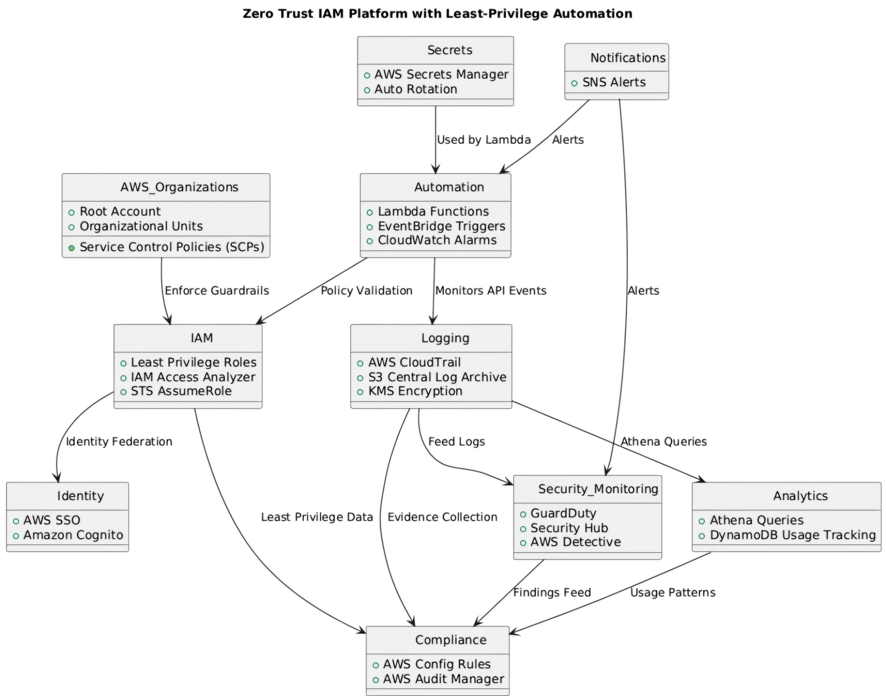

Slide 6
Implementation Steps: Building Secure Access
IAM Baseline & Access Analyzer
Initial setup of IAM roles and users. Configured IAM Access Analyzer to identify unintended external access to resources,
ensuring a secure starting point.
Logging & Monitoring
Enabled CloudTrail for all API activity logging. Integrated GuardDuty for intelligent threat detection, providing real-time
security insights across the AWS environment.
Least-Privilege Automation
Developed Lambda functions triggered by EventBridge rules to automatically remediate over-privileged roles.
SNS notifications for security alerts.
IAM Usage Analysis
Utilised Athena to query CloudTrail logs stored in S3, enabling detailed analysis of IAM permissions usage
to refine and optimise policies.

Slide 7

🔒 Testing and Validation: Proving Effectiveness
Rigorous testing ensured the platform's security and efficiency. We used multiple AWS tools to validate our implementation.
Validation Methods
CloudTrail Logs: Analysed API call patterns for unauthorized attempts and policy enforcement and IAM activity Trails.
IAM Access Analyzer: Verified Least-Privelege policies, detected unused permissions, and validated trust relationships.
GuardDuty Findings: Monitored alerts for suspicious activity and misconfigurations, validating real-time threat detection.
EventBridge + Lambda Alerts: Tested automated triggers on policy misconfigurations and unauthorized access attempts
Athena Log Queries: Custom SQL queries against CloudTrail data to confirm no excessive privelege escalations or policy violations.
Test IAM Users: Created test users with restricted roles to simulate least-privelege operations and validate access boundaries.
Key Validation Results:
Our validation confirmed a significant reduction in security risks and enhanced control over access.

Slide 8
Key Results: Tangible Security Enhancements
Our Zero Trust IAM platform delivered significant improvements in AWS security posture and operational efficiency.
40-60%
100%
2 min
100%
Reduced Over-Privileged Roles
Enforced Session-Based Access
Misconfiguration Flagging
IAM Usage Monitoring
Comprehensive visibility into permissions.
Through automated
least-privilege enforcement.
Implementing strict
Zero Trust principles.
Real-time detection and alerts.

Slide 9



Benefits of This Project
This project demonstrates practical skills in cloud security, automation, and effective risk management within AWS.
Improved Security Posture
Practical AWS Security Tool Application
Demonstrated Operational Security & Automation
Strengthened overall cloud security by adopting Zero Trust and least privilege principles, reducing vulnerabilities.
Gained hands-on experience with critical AWS security services like IAM, Access Analyzer, CloudTrail, and GuardDuty.
Showcased ability to implement automated security solutions, proving efficiency and proactive risk mitigation.

Slide 10
Challenges & Learnings
1
2
3
Handling False Positives
Balancing Security & Flexibility
Iterative Policy Improvement
Implementing robust filtering and fine-tuning automation logic was crucial to minimise erroneous alerts and actions.
Achieving a balance between stringent security policies and operational agility required iterative adjustments and stakeholder collaboration.
Continuous refinement of IAM policies based on real-world usage patterns and security insights proved vital for long-term effectiveness.

Slide 11
📚 Conclusion & Call to Action
This project served as an invaluable learning experience, bridging theoretical knowledge with practical AWS security implementation.
Key Learning Outcomes:
Deep understanding of Zero Trust and Least Privilege.
Proficiency in AWS security service integration.
Hands-on experience with cloud automation for security.
Ability to design and validate secure cloud architectures.
We encourage you to explore and implement Zero Trust IAM principles in your own AWS accounts for portfolio projects.

